Slide 1

Project Title – NETFLIX DATA ANALYSIS
[Student Name: Mattaparthi Teja ]
[AICTE Internship ID: APPLY_1755014250689b646aeda21]

Slide 2

PROBLEM STATEMENT
Netflix hosts a vast and diverse library of Movies and TV Shows across different countries and genres. However, with increasing global competition, Netflix must analyze its content distribution patterns to understand audience preferences, identify popular and underrepresented genres, and make data-driven decisions. This project aims to analyze Netflix’s content trends over the years to provide strategic recommendations for future content acquisition and production.

Slide 3
Project Description
This project focuses on performing data analysis on the Netflix dataset containing information about Movies and TV Shows from 2008 to 2021. The analysis includes:
Distribution of Movies vs TV Shows
Year-wise content addition trends
Country-wise contribution to Netflix’s catalog
Genre-wise popularity and evolution
Through visualization and statistical analysis, the project provides clear insights into Netflix’s content strategy, helping to identify strengths, gaps, and opportunities for global content expansion.

Slide 4

WHO ARE THE END USERS?
Netflix Management Team: – for making data-driven decisions on content strategy.
Marketing & Strategy Teams: – to identify popular regions and genres for targeted campaigns.
Data Analysts & Researchers: – for studying OTT trends and audience engagement.
Content Producers: – to understand which genres or countries have high potential for growth.

Slide 5

Technology Used
Programming Language: Python
Libraries: Pandas, NumPy, Matplotlib, Seaborn
Tools: Jupyter Notebook / Google Colab
Dataset Source: Netflix Titles Dataset (Kaggle)
Visualization & Reporting: Graphs, Charts, and Insights Summary

Slide 6
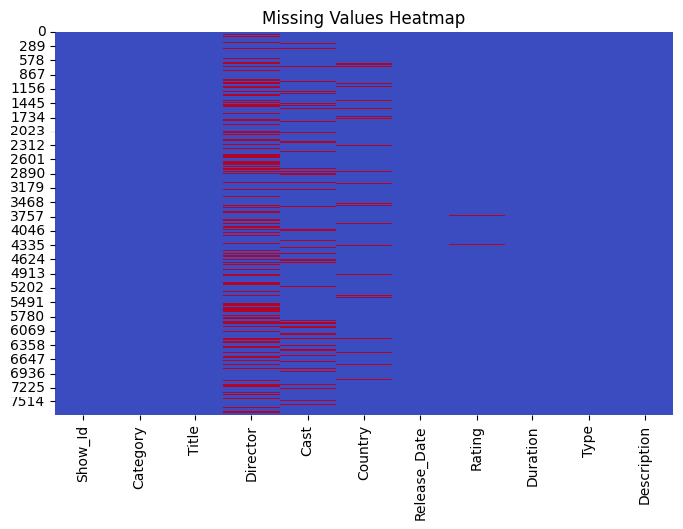
RESULTS1

Slide 7
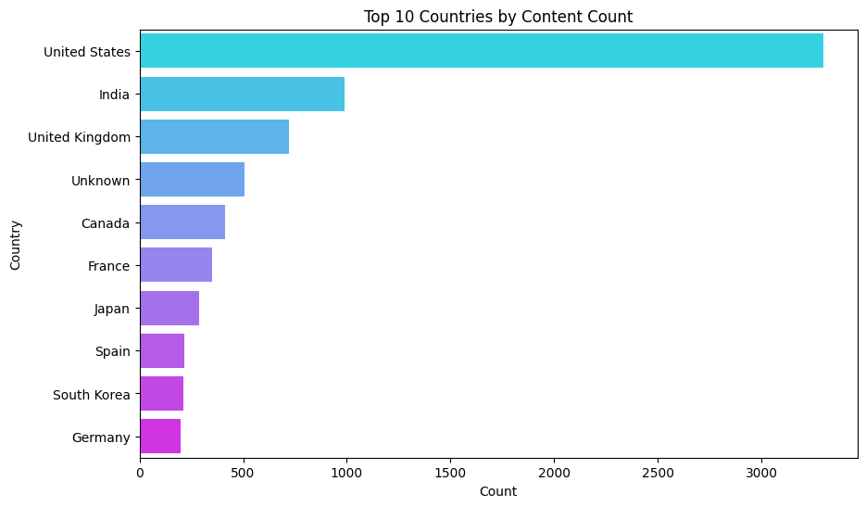
RESULTS2
[Add screen shots of your code or Chart(s) ]

Slide 8
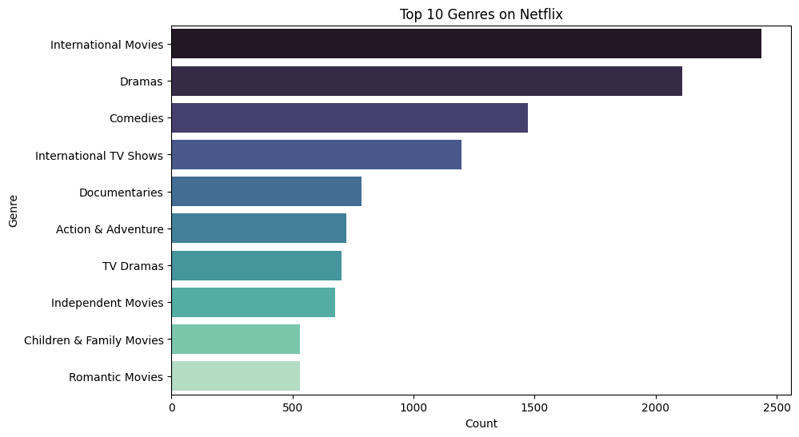
RESULTS3
[Add screen shots of your code or Chart(s) ]

Slide 9
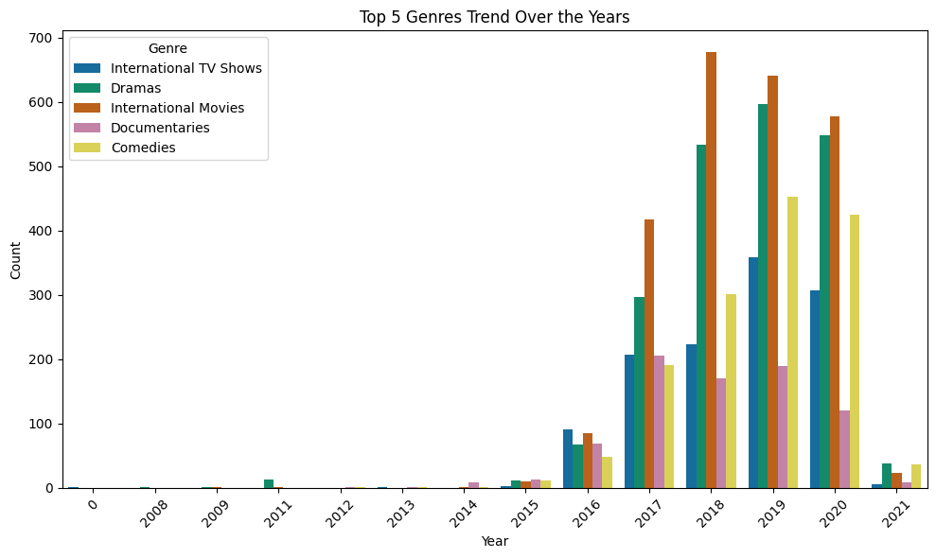
RESULTS4
[Add screen shots of your code or Chart(s) ]

Slide 10
GitHub repository
GitHub Repository Link/URL:
https://github.com/Teja1123-alt/Netflix_Data-Analysis_Project

Slide 11
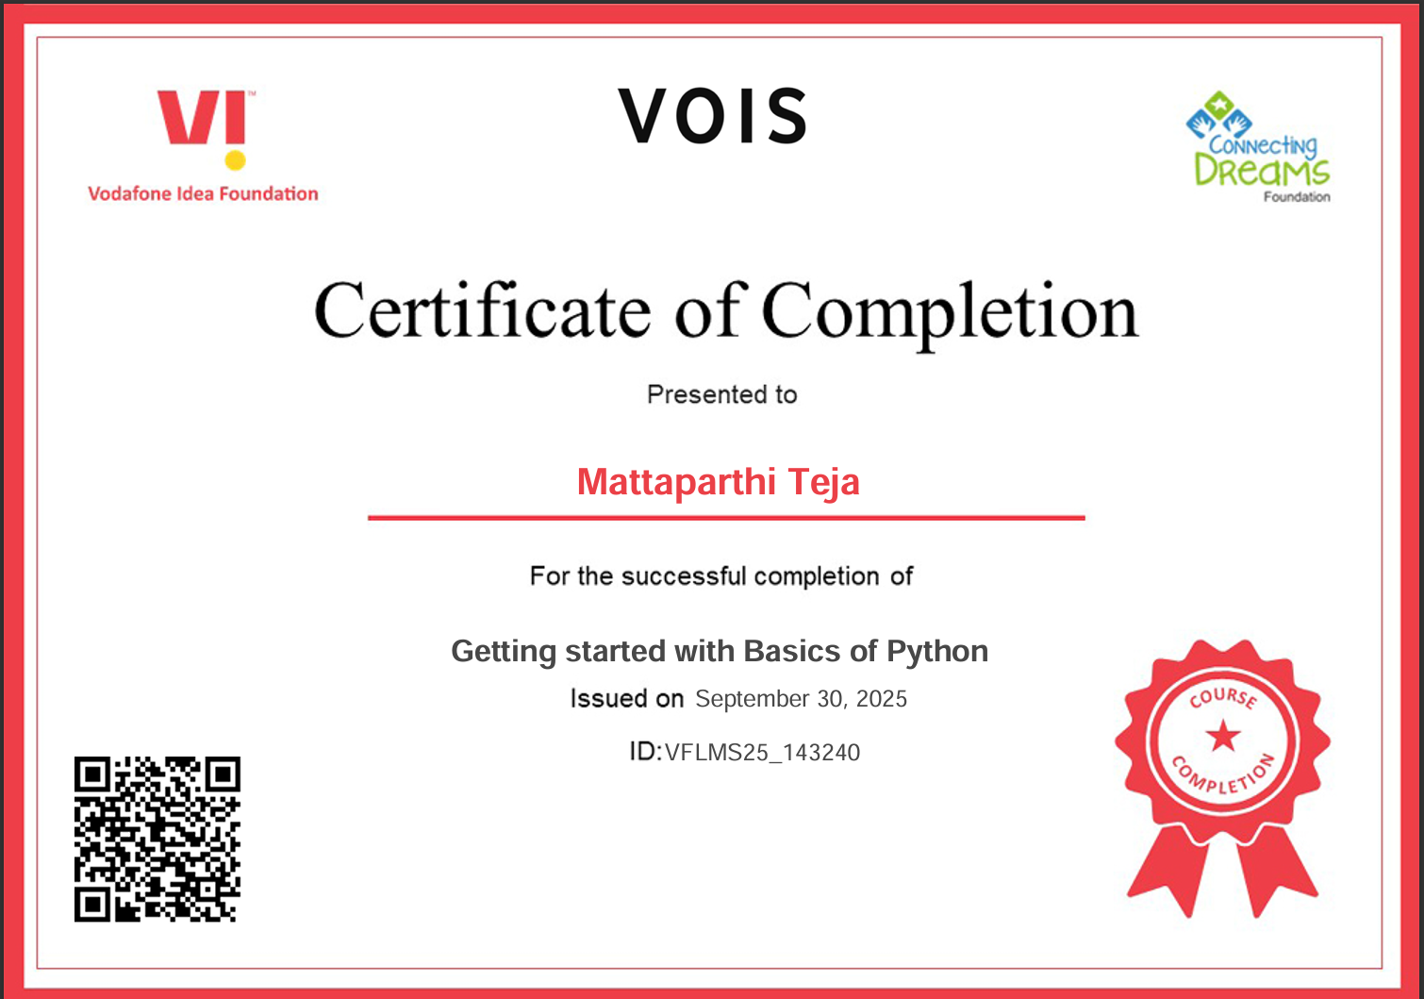
Getting started with Basics of Python Certificate
[Paste your Certificate Here]

Slide 12
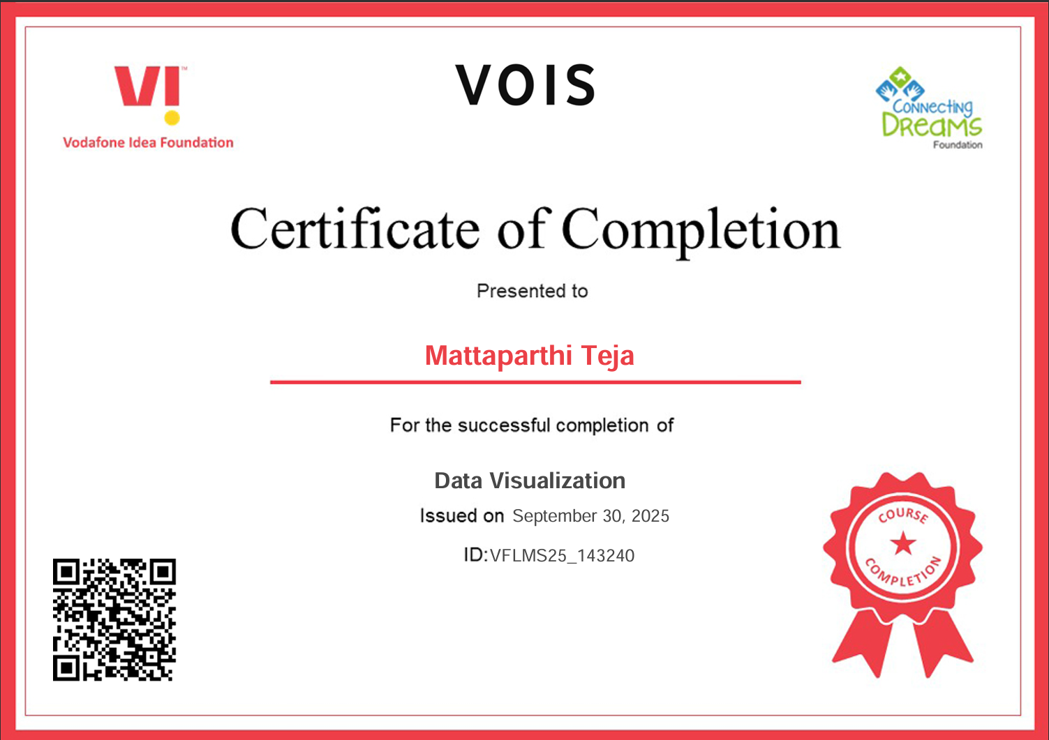
Data Visualization Certificate
[Paste your Certificate Here]

Slide 13
Thank you
.
.

